Slide 1
PROJECT:
UAE Restaurant Chain Operations Analysis
- Ekta Grewal

Slide 2
BUSINESS CONTEXT
An UAE-based restaurant chain operates multiple branches across different emirates and concepts. Management requires a centralized view of sales, operational efficiency, costs, profitability and menu performance.
Analysis :
The project analyzes branch, channel, menu, cost and operational performance to identify business drivers and performance gaps.
Outcome :
An integrated analytics solution providing descriptive, diagnostic and predictive insights for data-driven business decisions.

Slide 3
BUSINESS PROBLEM
The restaurant group generates large amounts of operational and sales data across branches, channels and menu items. However, management needs a consolidated analytical view to identify performance gaps and understand the factors affecting revenue and profitability.
Key Challenges:
How are revenue and order volumes changing over time?
Which order channels generate revenue and how do discounts and commissions affect them?
How do food, labour, waste and prime costs impact profitability?
Which menu categories and items contribute most to sales and margin?
Which branch, channel and menu characteristics are associated with revenue performance?

Slide 4
STAKEHOLDERS:
CEO / Management – Overall business performance and strategic decisions
Branch Managers – Branch sales, orders and operational performance
Finance Team – Revenue, costs and profitability
Operations Team – Daily operations, labour and cost efficiency

Slide 5
BUSINESS OBJECTIVE:
Analyze revenue and order trends
Compare branch and channel performance
Identify major cost drivers
Measure profitability and prime cost
Evaluate menu and category performance
Identify operational efficiency patterns
Develop a feature-based revenue prediction model

Slide 6
DATA AVAILABILITY & DATA DESCRIPTION
This project utilizes a custom-built UAE Restaurant Chain Operations database.
The database contains five related tables with restaurant business data about:
Branches
Daily Operations
Sales Channels
Menu Items
Monthly Item Sales
Table | Rows | Columns | Business Content
BRANCHES | 18 | 10 | Branch location, concept, seats, delivery/drive-thru and rent
DAILY_OPERATIONS | 16,416 | 19 | Daily sales, orders, covers, food/labour/waste costs
CHANNEL_DAILY | 67,488 | 21 | Daily performance by sales channel
MENU_ITEMS | 98 | 10 | Menu item details, price, cost, category and attributes
ITEM_MONTHLY_SALES | 46,980 | 10 | Monthly item sales, quantity, food cost and gross margin

Slide 7
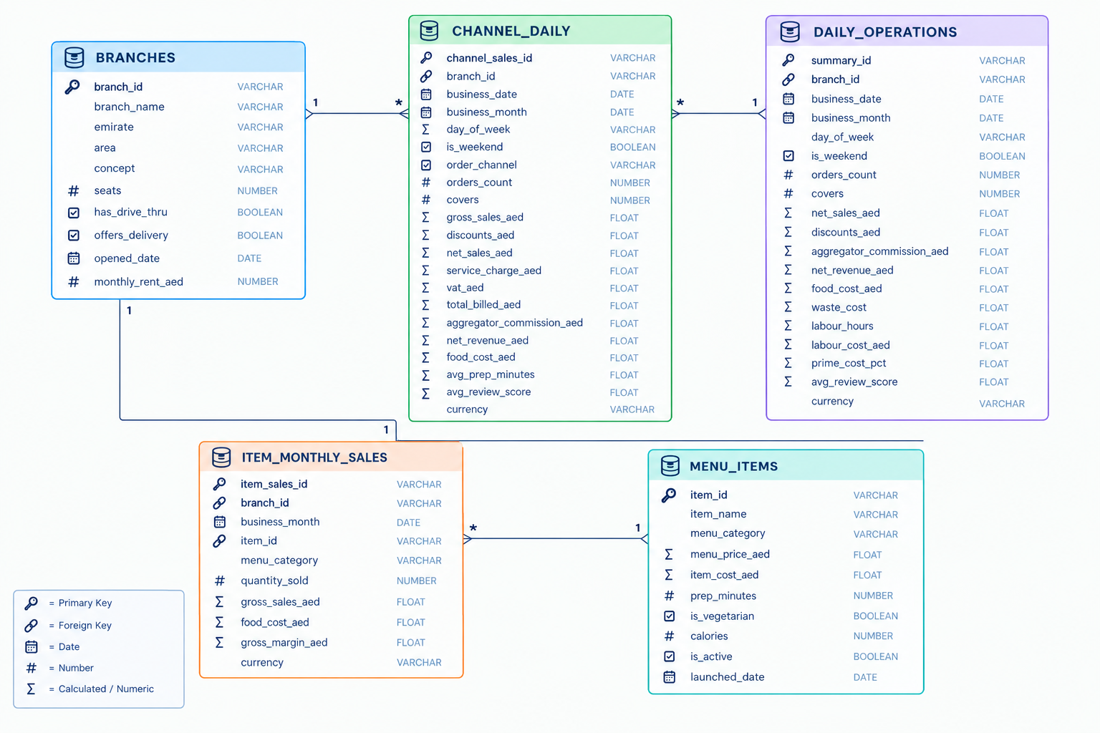
ER DIAGRAM
The data model separates branch, operational, channel and menu information while maintaining clear relationships for analysis.

Slide 8
DATA DICTONARY
BRANCHES
Column | Description
branch_id (PK) | Unique id for each branch
branch_name | Trading name of the outlet.
emirate | Emirate the branch trades in.
area | District or development within the emirate.
concept | Quick Service, Café, Casual Dining or Fine Dining.
seats | Covers the dining room can seat.
has_drive_thru | branch has a drive-thru lane
offers_delivery | when the branch delivers
opened_date | Date the branch opened
monthly_rent_aed | Monthly rent
MENU ITEMS
Column | Description
item_id(PK) | Unique id for each ITEM
item_name | Menu name of the dish.
menu_category | Appetizers, Mains, Grills, Sandwiches, Sides, Desserts, Hot Drinks or Cold Drinks.
menu_price_aed | Menu price per portion.
item_cost_aed | Recipe cost per portion — the basis of item margin.
prep_minutes | Standard preparation time, in minutes.
is_vegetarian | Whether the dish is vegetarian
calories | Calories per portion.
is_active | No marks a dish removed from the menu
launched_date | Date the dish joined the menu

Slide 9
DATA DICTONARY
DAILY OPERATIONS
Column | Description
summary_id (PK) | Unique id for each branch
branch_id | Foreign key
business_date | Trading date
business_month | Trading month
day_of_week | Day name
is_weekend | Yes for Saturday and Sunday
orders_count | Orders across every channel.
covers | Guests seated.
net_sales_aed | Sales after discounts
discounts_aed | Discounts - across the day.
DAILY OPERATIONS
Column | Description
aggregator_commission_aed | Commission surrendered to delivery platforms
net_revenue_aed | Net sales less aggregator commission
food_cost_aed | Unique id for each branch
waste_cost_aed | Foreign key
labour_hours | Trading date
labour_cost_aed | Trading month
prime_cost_pct | Day name
avg_review_score | Yes for Saturday and Sunday
currency | Currency, constant AED.

Slide 10
DATA DICTONARY
CHANNEL DAILY
Column | Description
channel_sales_id(PK) | Unique id for each branch
branch_id | Foreign key
business_date | Trading date
business_month | Trading month
day_of_week | Day name
is_weekend | Yes for Saturday and Sunday
orders_count | Orders across every channel.
order_channel | Dine-in, Takeaway, Drive-Thru, Own Delivery or Aggregator Delivery
covers | Guests seated.
gross_sales_aed | Menu value before discounts.
discounts_aed | Discounts given on this channel.
CHANNEL DAILY
Column | Description
net_sales_aed | Gross sales less discounts
service_charge_aed | 10% service charge.
vat_aed | UAE VAT at 5% on net sales
total_billed_aed | What the guest was charged: net sales + service charge + VAT.
aggregator_commission_aed | 25% platform commission.
net_revenue_aed | Net sales less that commission
food_cost_aed | Recipe cost
avg_prep_minutes | Average preparation time
avg_review_score | Average guest rating
currency | Currency, constant AED.

Slide 11
DATA DICTONARY
ITEM MONTHLY SALES
Column | Description
item_sales_id (PK) | Unique id for each branch
branch_id | Foreign key
item_id | Foreign key to menu_items.item_id.
menu_category | The dish's category, repeated here so menu mix needs no join.
quantity_sold | Portions sold that month.
gross_sales_aed | Menu value sold
food_cost_aed | Recipe cost of those portions.
gross_margin_aed | Sales less food cost
currency | Currency, constant AED.

Slide 12
ANALYSIS PLAN:
DESCRIPTIVE ANALYSIS
DIAGNOSTIC ANALYSIS
PREDICTIVE ANALYSIS
What happened?
Why did it happen?
What can we predict from the available drivers?
Food cost
Labour cost
Waste cost
Discounts
Aggregator commissions
Prime cost
Profitability
Revenue trends
Order trends
Branch performance
Channel performance
Menu performance
Revenue prediction
Feature-based business performance modelling

Slide 13
Technology Stack & Analytical Workflow
8
How the project moves from raw data to decisions
Excel
Snowflake
Databricks / Python
Power BI
PPT
Initial inspection
Storage + SQL
Analysis + modelling
Interactive reporting
Storytelling + recommendations
Analytical flow
Raw tables → data validation → SQL transformations → analytical dataset → KPI analysis → dashboard → recommendations

Slide 14
Python Analysis:
EDA, Predictive Analysis & Business Insights
Objective: To analyze restaurant sales, branch, channel, menu and operational performance, and apply predictive modelling to support data-driven business decisions.
Sales & Revenue Analysis
Channel & Menu Analysis
Understand revenue trends and restaurant sales performance.
Evaluate sales contribution across channels and menu categories.
Monthly Revenue Trend
Monthly Orders Trend
Revenue by Branch
Weekend vs Weekday Revenue
Revenue by Order Channel
Gross Sales by Menu Category
Quantity Sold by Menu Category
Category-wise Sales Performance
Cost & Operational Analysis
Revenue Prediction
Analyze restaurant costs and operational efficiency.
Predict restaurant revenue using business and operational features.
Revenue vs Food Cost
Branch-wise Prime Cost
Prime Cost % by Branch
Food & Labour Cost Analysis
Linear Regression
R2 Score
MAE
MSE
Actual vs Predicted Revenue
KEY FINDINGS:
No Missing Values | No Duplicate Records | No Negative Values | R²: 97.68% | MAE: AED 2,756.69 | RMSE: AED 3,976.36

Slide 15
PREDICTIVE MODELING APPROACH
Feature-based revenue prediction in Databricks
01 Data Preparation
02 Feature Engineering
03 Feature Selection
Clean branch, channel, menu and operational datasets.
Create branch, channel, menu and operational features.
Select relevant numerical and categorical variables.
04 Train / Test Split
05 Linear Regression
06 Evaluation
80% training • 20% testing • random_state = 42.
Revenue used as the target variable.
MAE • RMSE • R² • Actual vs Predicted.
The current model uses same-period business features. Describe it as feature-based revenue prediction, not as a true time-series future forecast.

Slide 16
Power BI Dashboard:
Interactive Dashboards for Data-Driven Decision Making
Objective: To develop interactive Power BI dashboards that monitor key business performance evaluate branch & Operational performance helping stakeholders identify trends and make data-driven decisions.
Executive Overview
Branch & Operations
Menu & Profitability
Monitor overall business performance, profitability, growth.
Evaluate Branch & Operational Performance
Measure Menu Performance & Profitability.
Revenue & Orders
AOV & Gross Margin
Prime Cost
Net Profit
Monthly Trends
Branch Revenue
Orders & AOV
Food Cost
Labour Cost
Prime Cost
Weekend vs Weekday
Category Sales
Quantity Sold
Gross Margin
Top Menu Items
Margin %

Slide 17
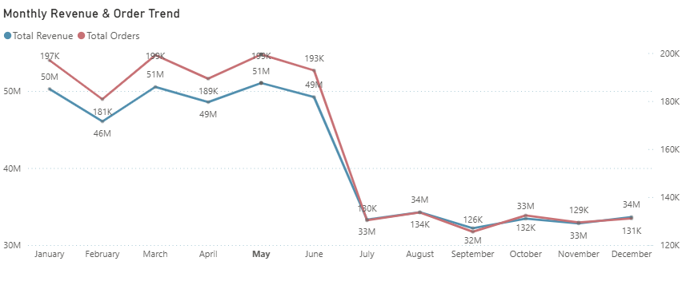
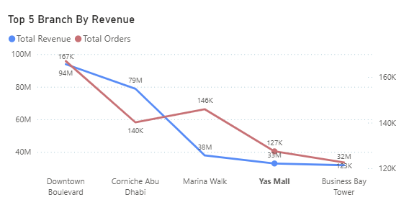
EDA - SALES & BRANCH PERFORMANCE
Branch-level comparison highlights differences in revenue, order volume and average order value.
TOTAL REVENUE
TOTAL ORDERS
AOV
495.3 M
1.94M
255

Slide 18
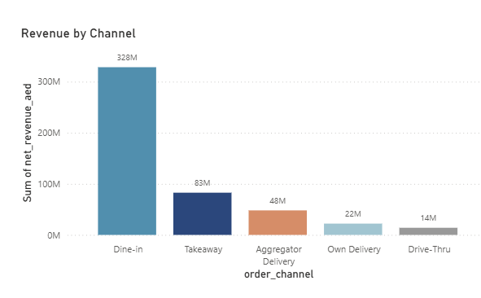
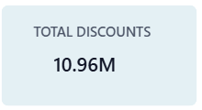
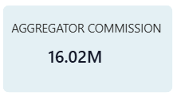
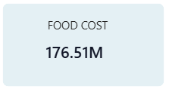
EDA - CHANNEL & COST PERFORMANCE
Channel sales should be evaluated alongside discounts and commissions, while food and labour costs remain key drivers of prime cost and profitability.
COST PERFORMANCE
FOOD COST
35.6%
PRIME COST
41.6%
WASTE COST
1.07%
LABOUR COST
5.99%

Slide 19
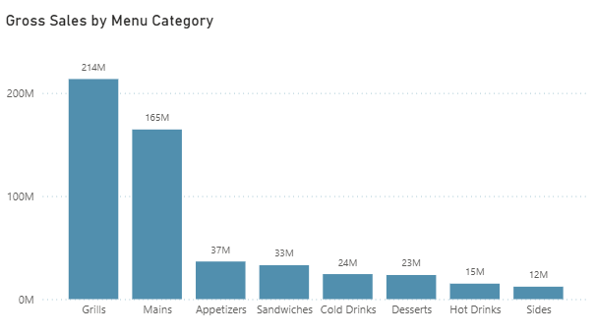
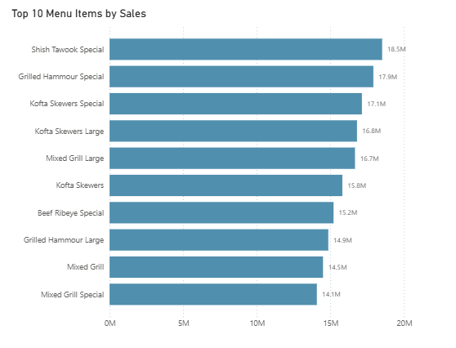
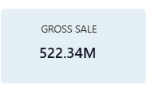
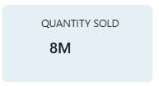
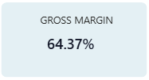
EDA - MENU & CATEGORY PERFORMANCE
Menu analysis identifies categories and individual items contributing significantly to sales volume and revenue.

Slide 20
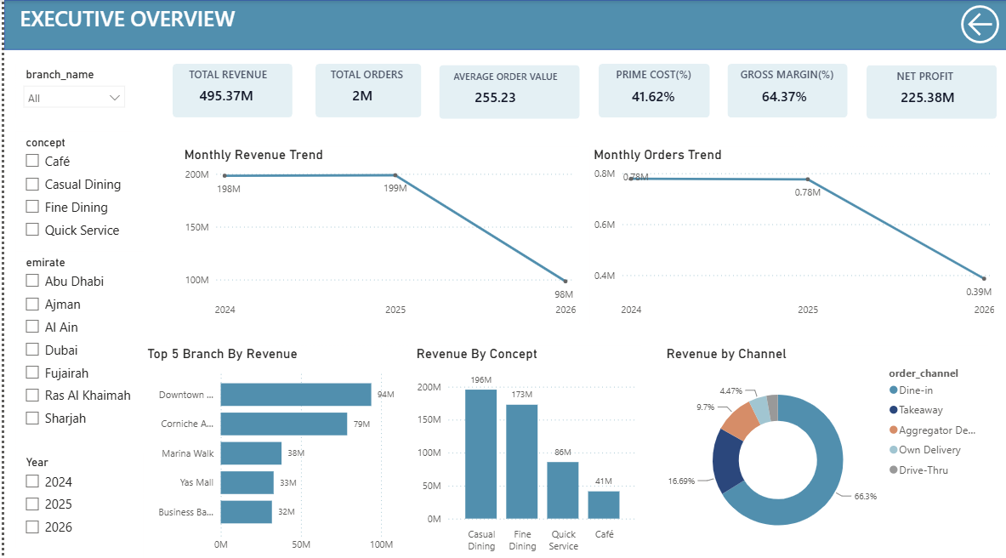
Dashboard Page 1 - Executive Overview

Slide 21
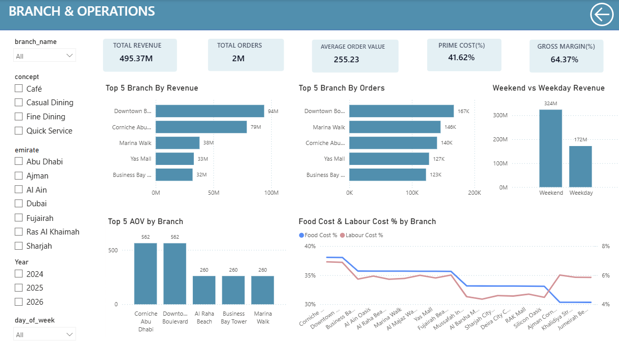
Dashboard Page 2 - Branch & Operations

Slide 22
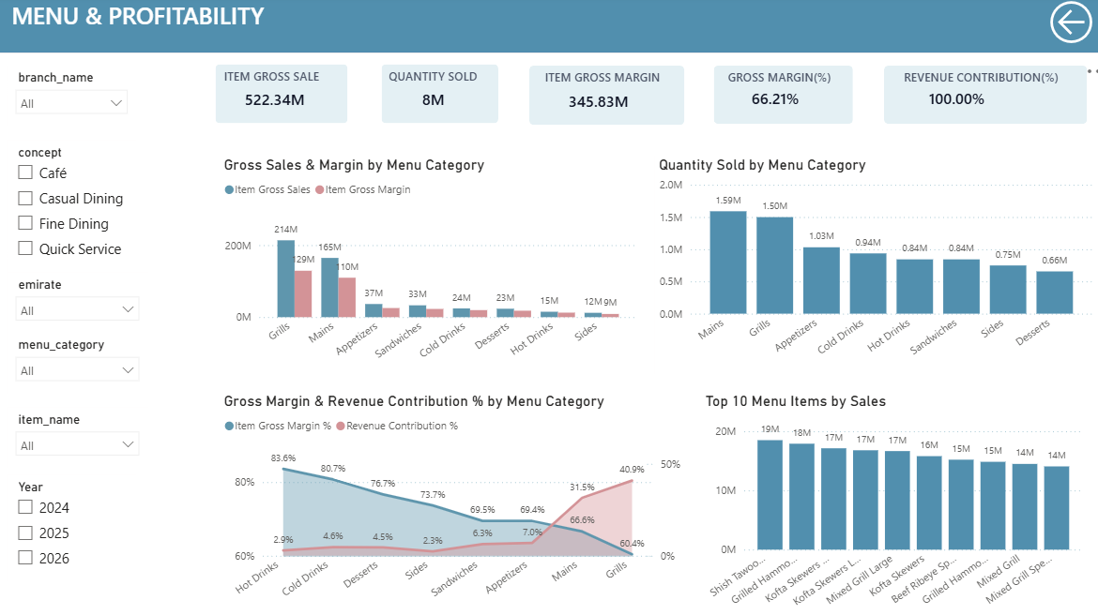
Dashboard Page 3 – Menu & Profitability

Slide 23
Key Business Insights:
Business findings from SQL, Databricks and Power BI
SALES PERFORMANCE
Revenue and order trends show clear variation across months, highlighting changing demand patterns.
BRANCH PERFORMANCE
Branch-wise analysis identifies differences in revenue, order volume and AOV, helping management focus on branch-level performance.
CHANNEL PERFORMANCE
Order channels contribute differently to revenue, while discounts and aggregator commissions affect the net revenue generated.
COST & PROFITABILITY
Food and labour costs are the major components of prime cost, making cost control important for maintaining profitability.
MENU PERFORMANCE
Menu categories and individual items contribute differently to sales volume, revenue and gross margin, supporting data-driven menu optimization.
REVENUE PREDICTION
The Linear Regression model achieved R² = 0.9768, with MAE = AED 2,756.69 and RMSE = AED 3,976.36, showing a strong fit on the evaluated dataset.

Slide 24
Recommendations:
1. BRANCH OPTIMIZATION
Investigate branches with persistently lower revenue or higher cost ratios.
2. CHANNEL OPTIMIZATION
Review discount and aggregator commission impact before increasing channel volume.
3. COST CONTROL
Track food + labour together and focus on branches with consistently high prime cost.
4. MENU OPTIMIZATION
Promote high-margin menu items and review low-margin items based on sales volume, revenue contribution and profitability.
5. OPERATIONAL EFFICIENCY
Use AOV, covers, preparation time and review scores to identify service improvements and operational bottlenecks.

Slide 25
Thank You
-Ekta Grewal

